Slide 1

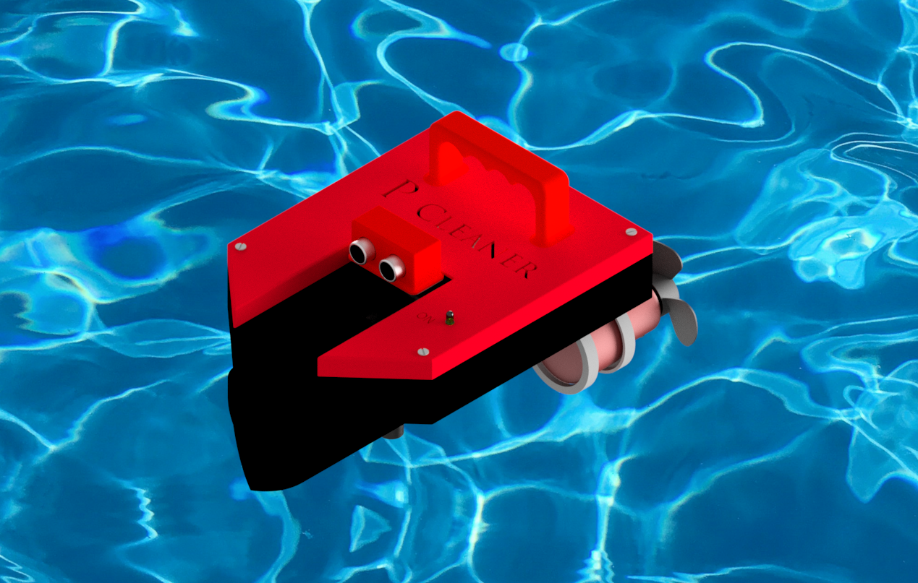
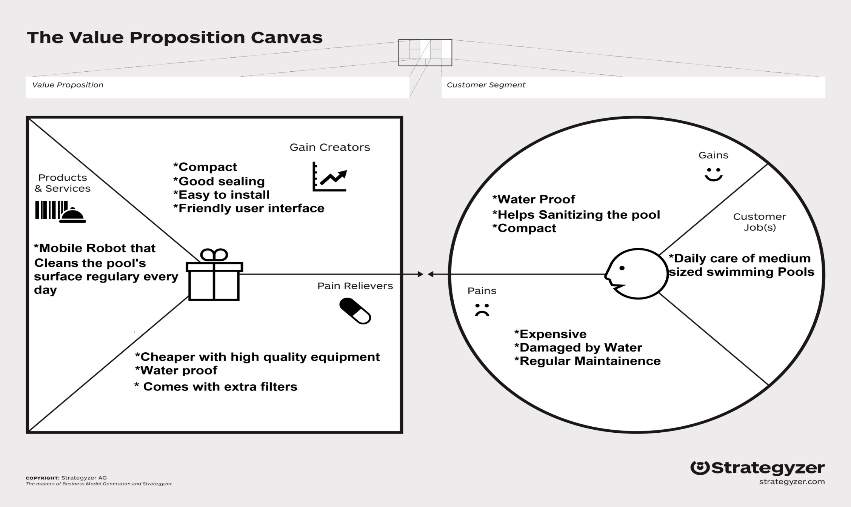
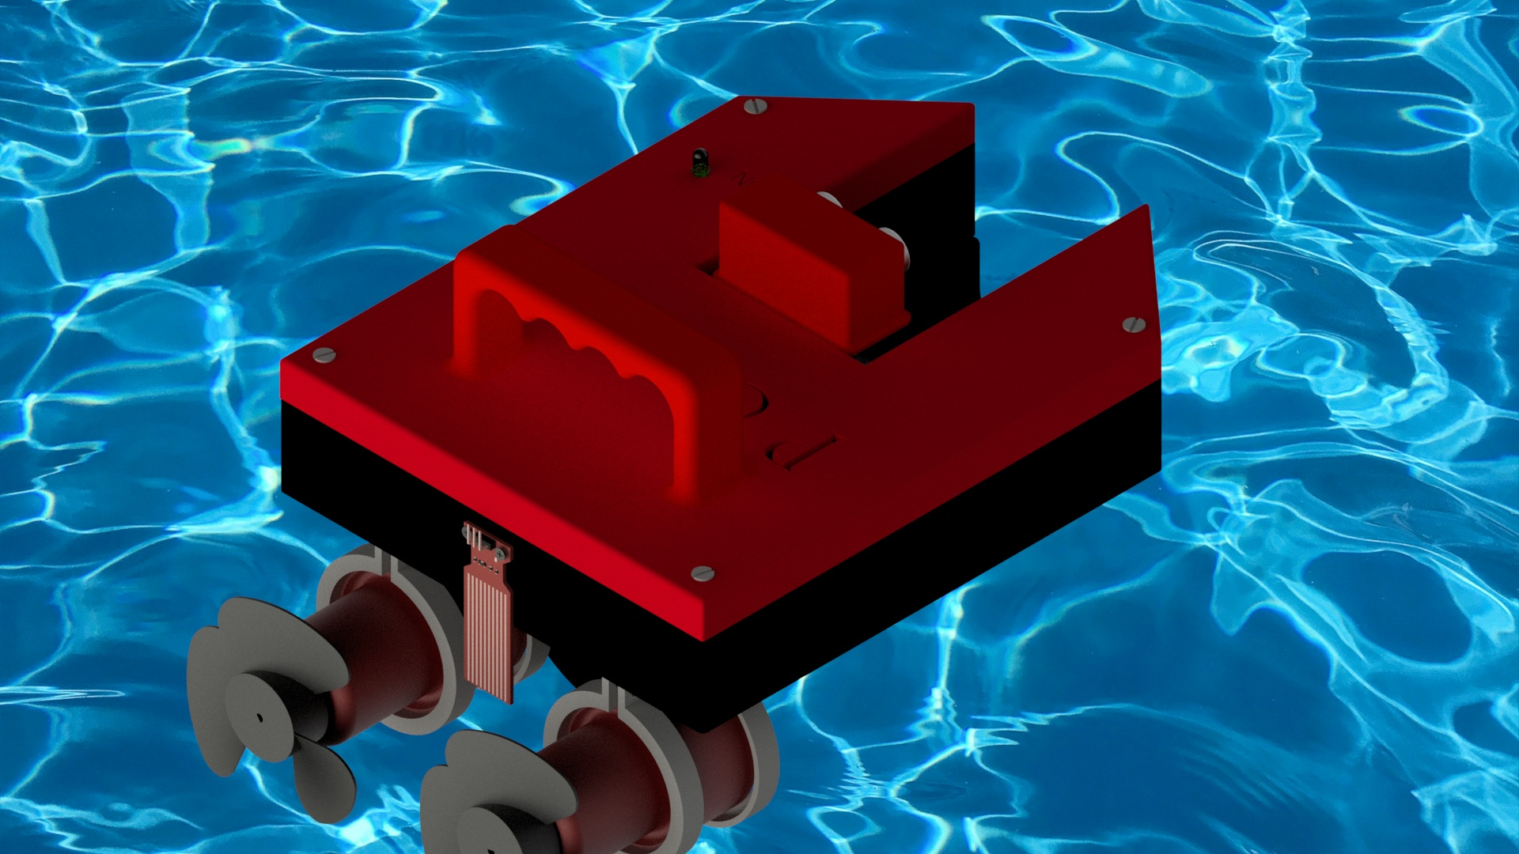
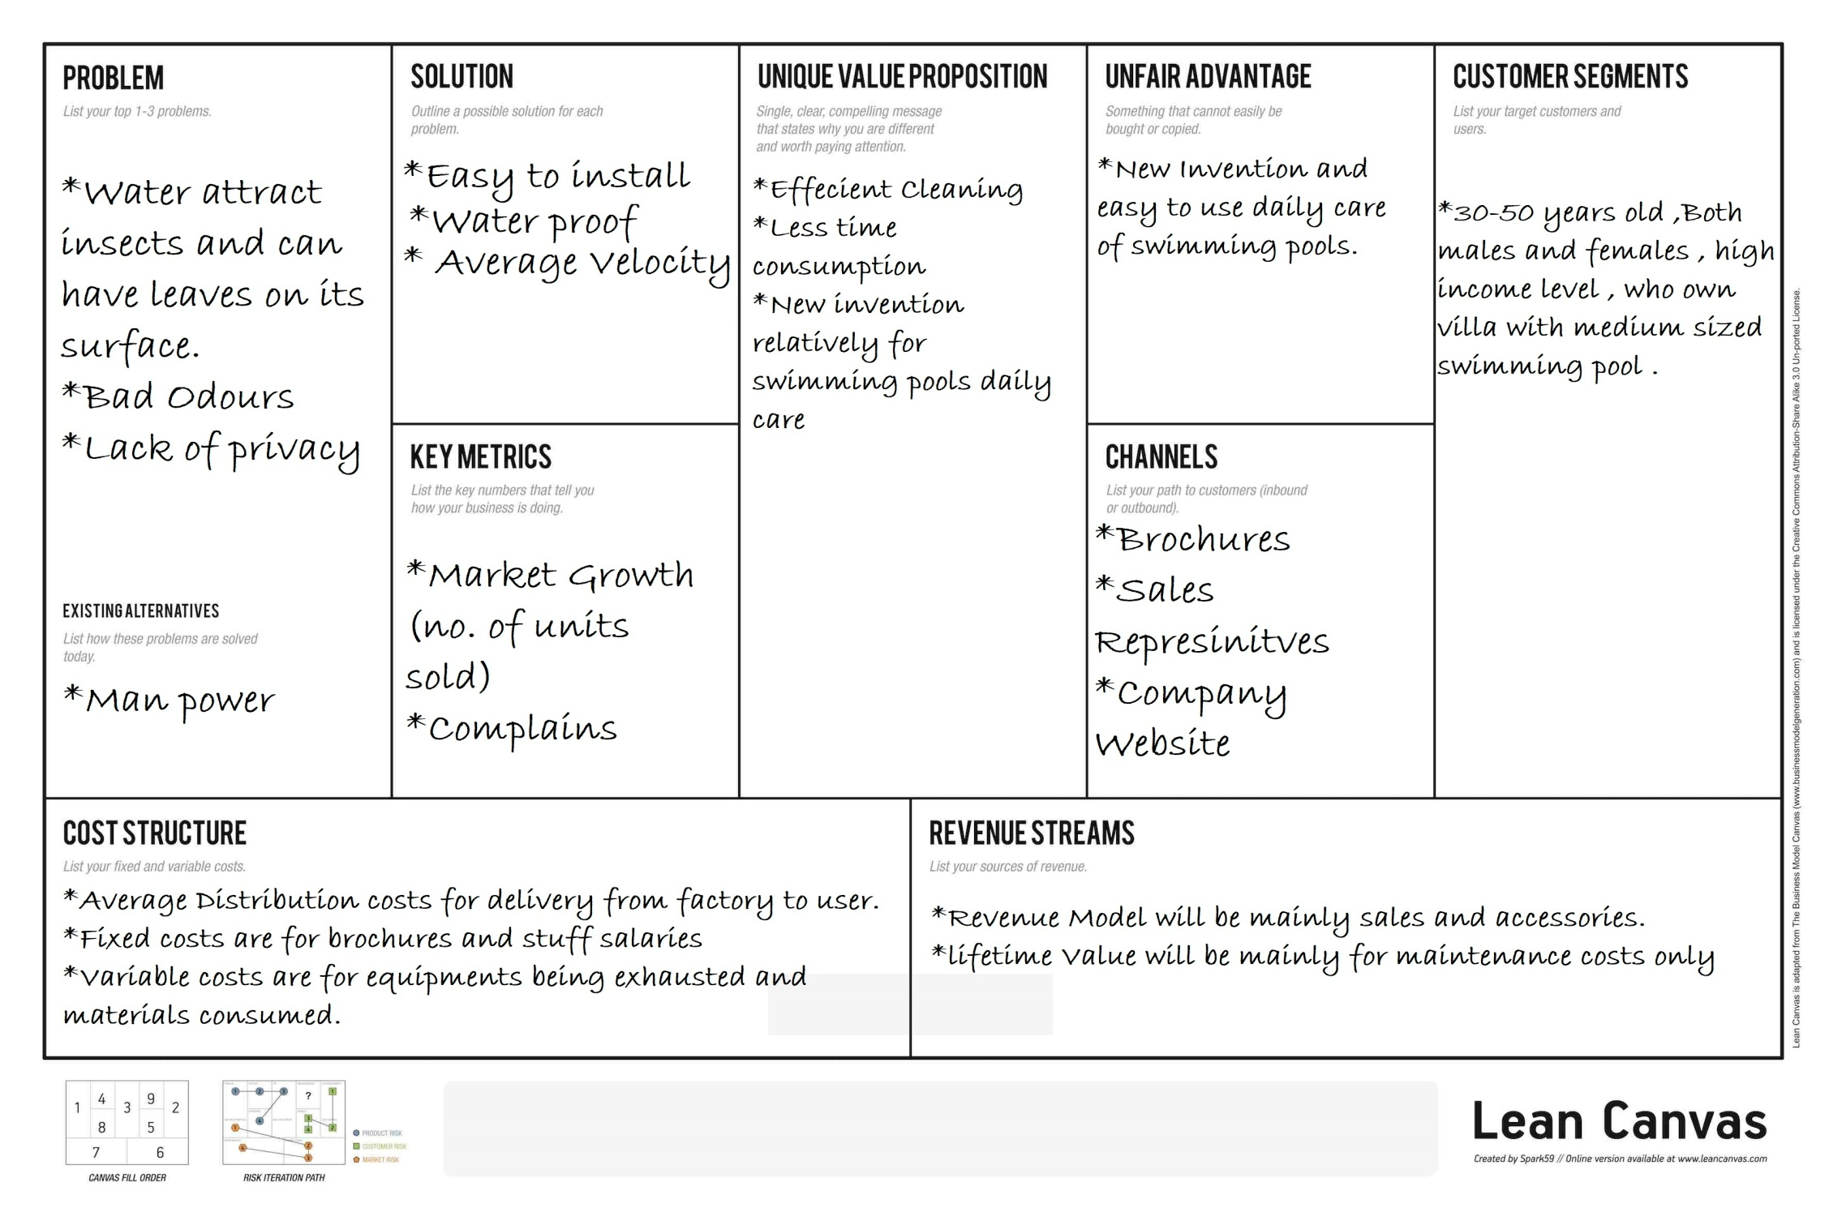
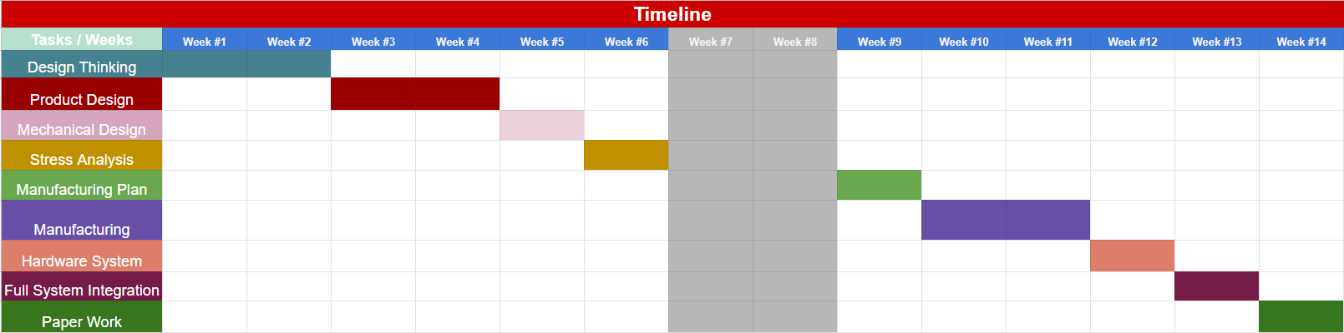
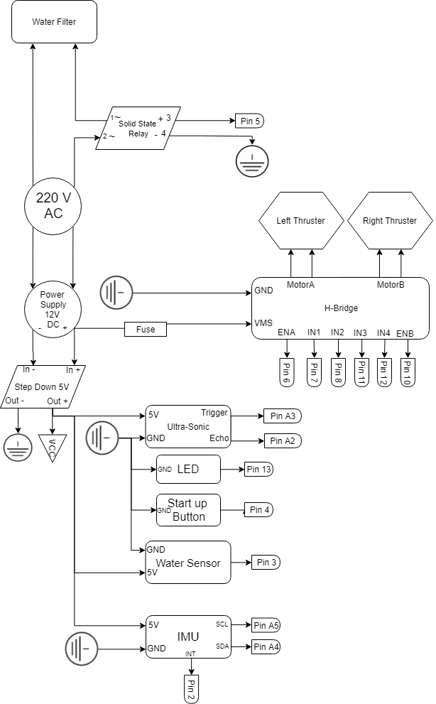
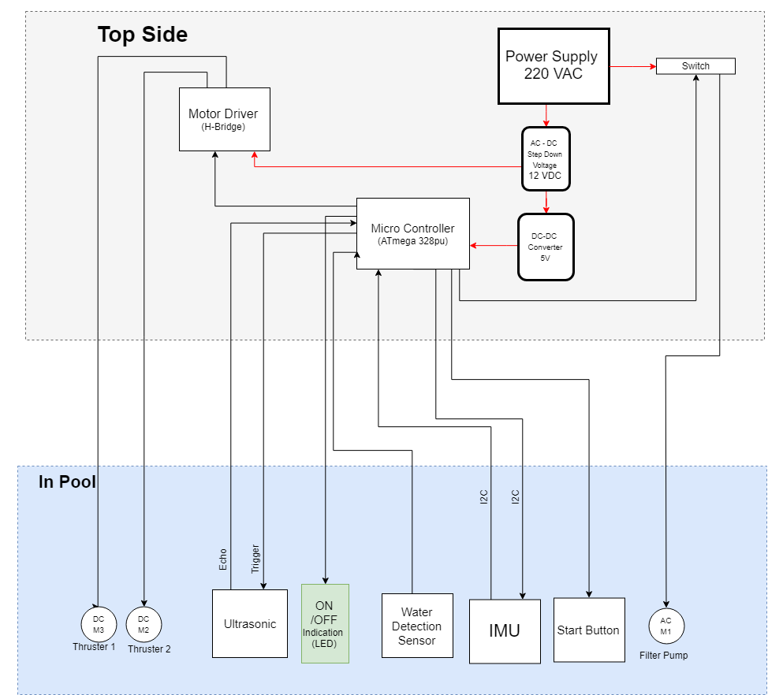
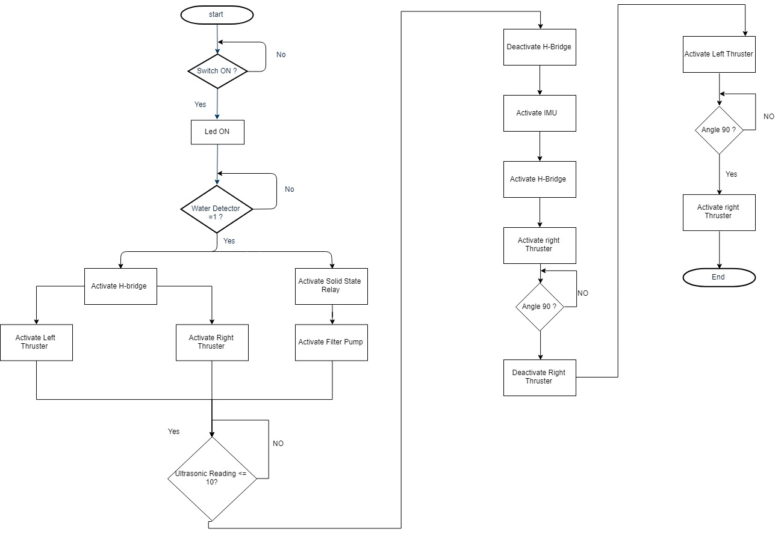
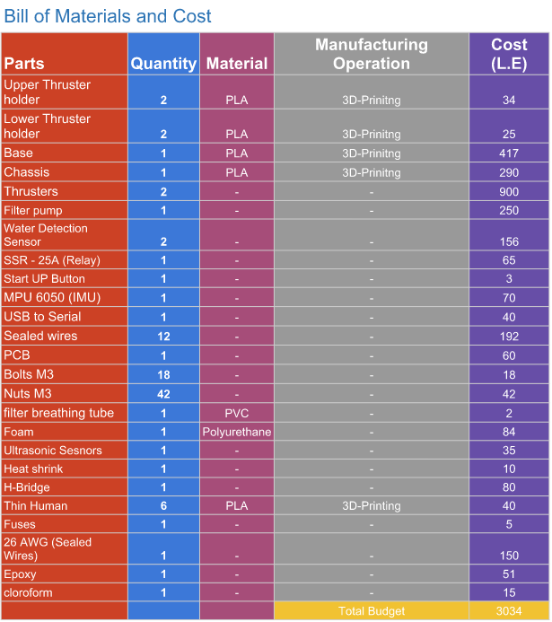
Ahmed Amr
Philopatear Salib
Nourhan Ayman
PCleaner
Abstract
Product design
Design Thinking process
Market research results
Our projects goal was to offer daily caring routines to medium sized swimming pools , owned by 30-50 year old males or females , in a villa or a compound.
Function
Our main goal was to clean any medium sized pool , in the most efficient way . And still maintaining privacy and safety. Our robot works autonomously , with a really simple user interface that requires no effort and has no complexity.
Business Model Canvas
Project timeline
Specs and features
Easy to install
Compact
Low time consumption cleaning
Low maintenance time
Very simple user interface
Lean Model Canvas
Electrical aspects
Bill of materials and cost
SID-Model

